Slide 1
Leading Practices for Cross Bore Risk Reduction
Gas Distribution Safety Focus
By: Mark Bruce, President, Cross Bore Safety Association
www.crossboresafety.org

Slide 2

Leading Practices for Cross Bore Risk Reduction
Requested from industry & regulator because of concerns showing need for a detailed guidance document
Existing cross bore inspections and construction efforts have, in some cases reported an area cleared of cross bore risks, but cross bores were found subsequently.
Requires high confidence cross bore reduction efforts.
Verifiable QAQC’d processes, accurate GPS and GIS are recommended
Accurate Verifiable Data is REQUIRED!

Slide 3
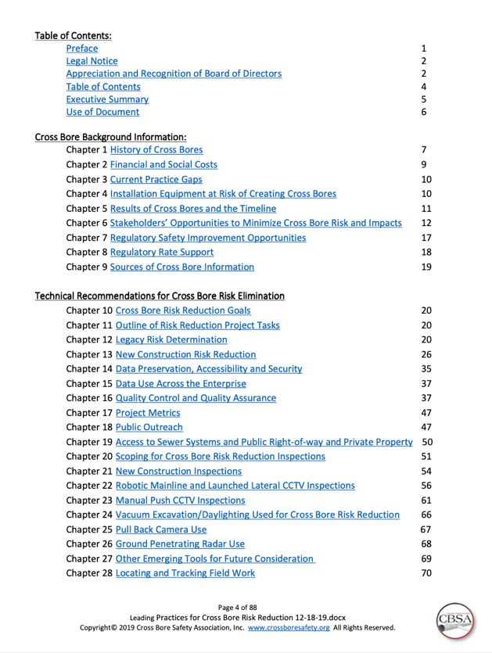
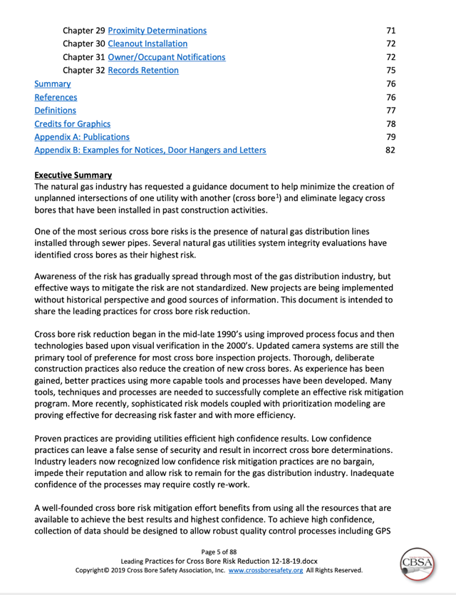
32 Chapters, 88 pages, 23 Figures, 33 References, 12 Example Notices

Slide 4
Presentation Preview
Focus Gas in Sewer Cross Bores
  Discuss installations resulting in cross bores
  Illustrate the risks
  Quantify the expected number of cross bores
  Consequences
  Benefits of cross bore risk reduction efforts
  Development of Leading Practices by CBSA
  Elements of Leading Practices
  Final Leading Practices Availability November, 2019

Slide 5
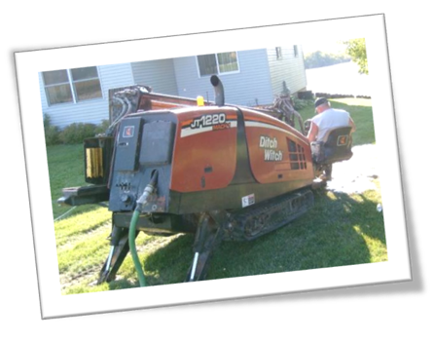

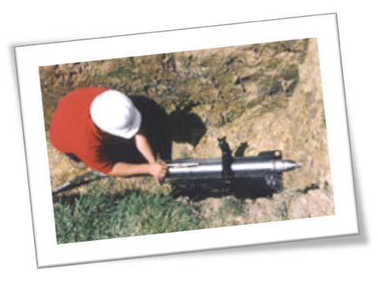
What’s the Cross Bore Problem?
  Trenchless installations do not “see” existing lines creating potential intersections
  Sewer utilities are often unmarked and excluded from most 811 requirements, leading to substantial risk.
  All types of buried utilities are at risk from cross bores.
  Gas - sewer cross bores have been the focus of most cross bore risk reduction.

Slide 6
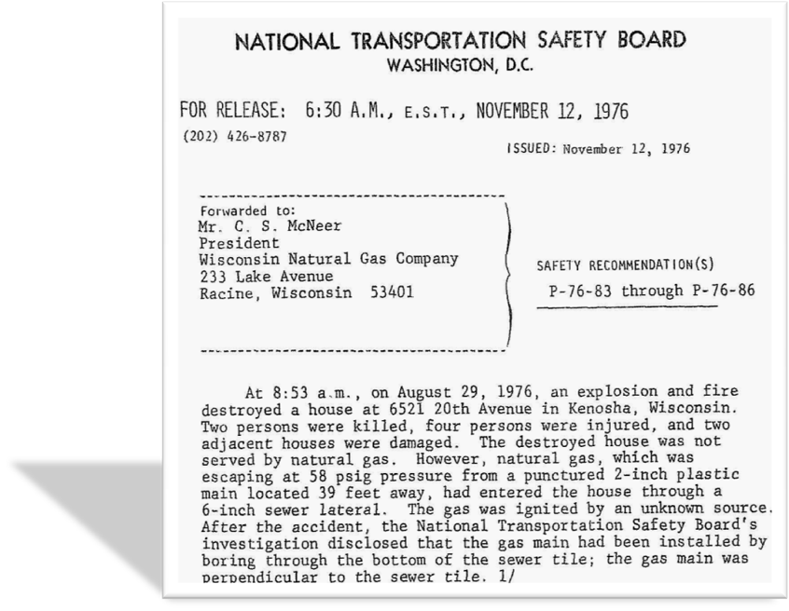
Cross Bores - Recognized Since 1976 by NTSB
2 persons killed
4 persons injured
Punctured 2-inch plastic main.
Entered house through 6” sewer lateral.
Bored through bottom of the sewer tile.

Slide 7
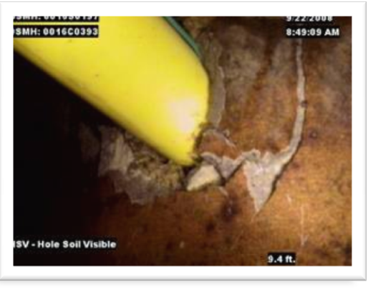
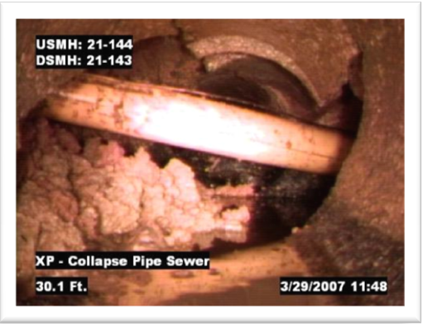
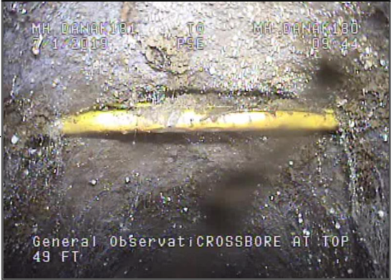
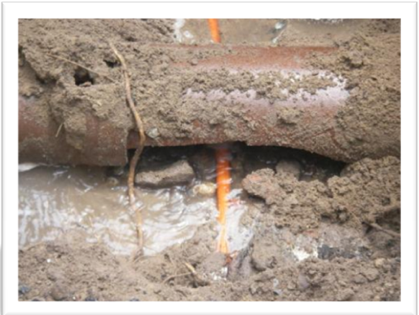
Cross Bores – Class 1, Typically Lays Dormant
One Utility Intersects One Other Utility
Notes:
Taken from robotic CCTV cameras.

Slide 8
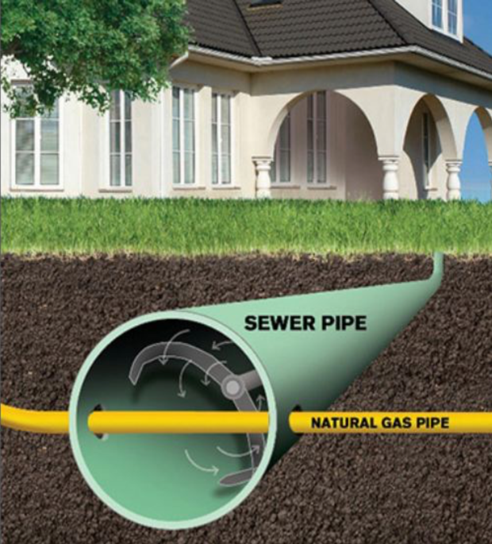
Cross Bores Are At Risk From Drain Cleaning Actions
Rotating cutting devices used to clear blocked residential and mainline sewers can cut cross bored utilities.
Explosion, injury and death have resulted from ignited gas released from cross bores
$30 million per explosion have been reported

Slide 9
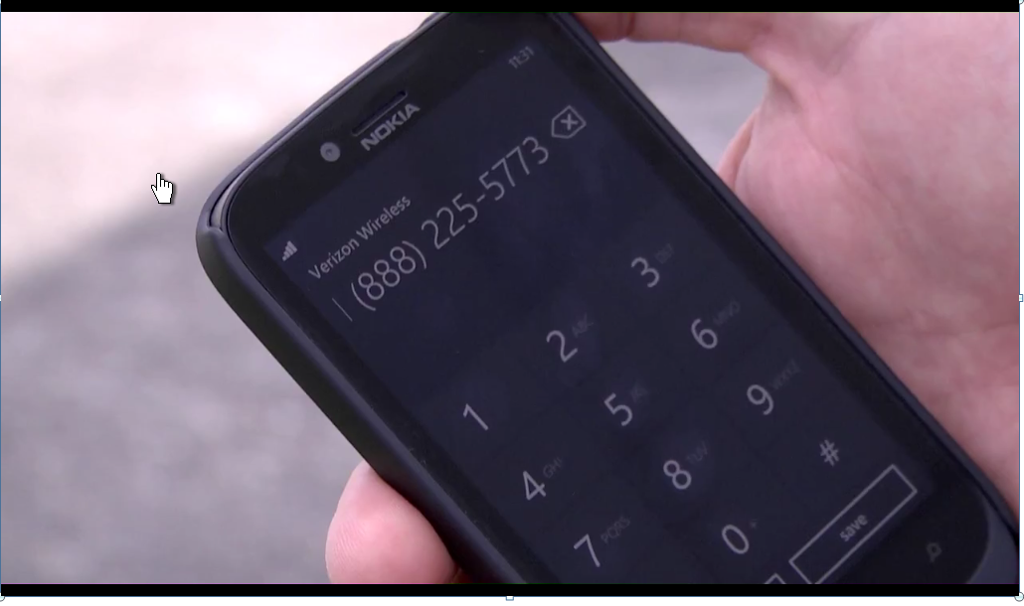
Community Outreach - Web, Radio Spots, Letters, Videos, Sandwich Boards, Theatre Spots
Online Links to Video:
https://www.pse.com/safety/NaturalGasSafety/Pages/Blocked-Sewer.aspx
http://www.youtube.com/watch?v=jPAR-3YiSEM&feature=youtu.be
Click on Image to Play
Notes:
Make your program positive to the community. Ask for their cooperation.

Slide 10
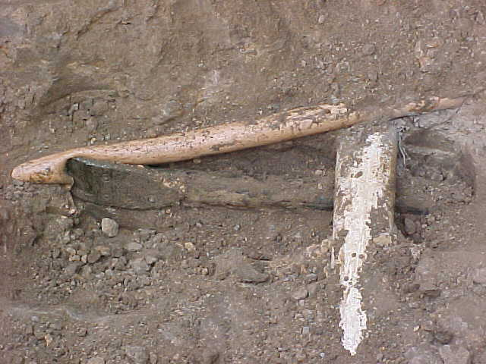

Class 2 Cross Bore – Immediate Explosion Risk
Two Existing Utilities Intersected by Third Utility
Gas Line
← Gas Flows to House
HDD Drill Head for fiber optics penetrates gas
Sanitary Sewer Line

Slide 11
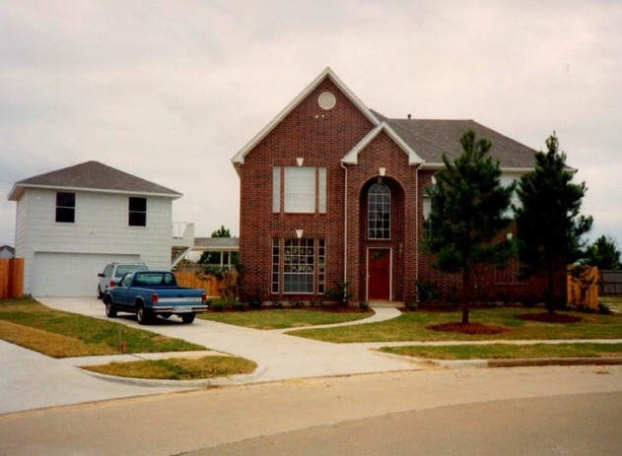
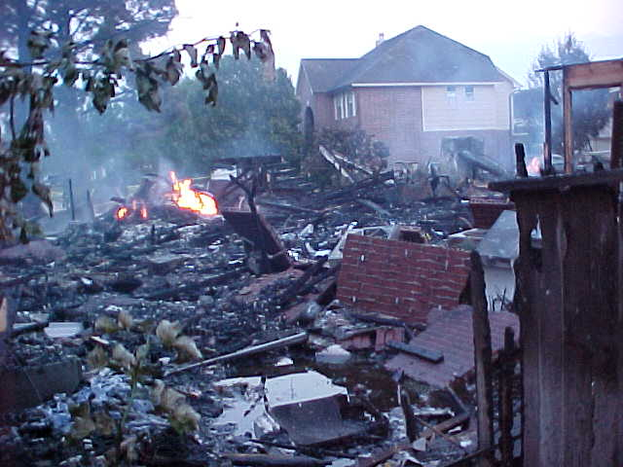
Cross Bore Explosion - Class 2 Cross Bore
(see prior slide of this Class 2 cross bore)
Before
After

Slide 12
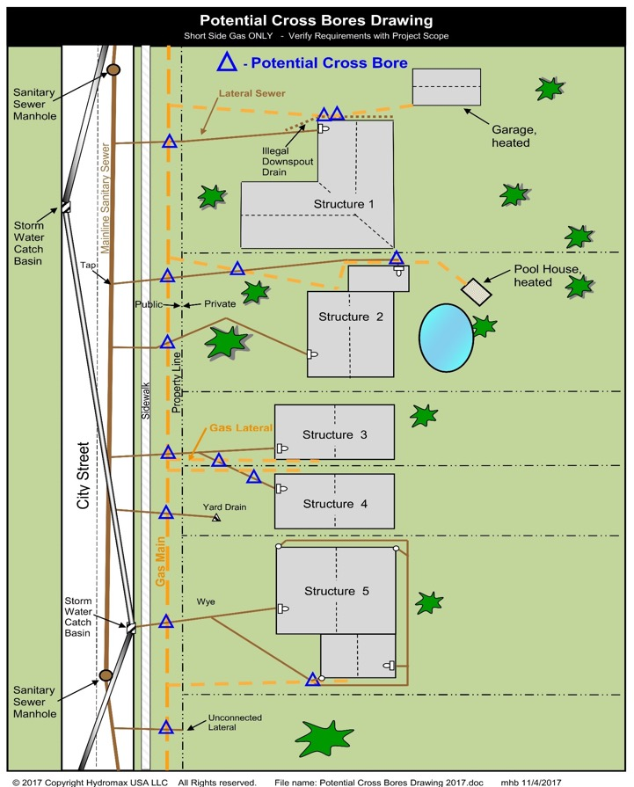
Potential Cross Bore Crossings - Gas In Sewer
Intersections Shown (16):
  Sanitary sewers
  Storm sewers
  Yard drains
  Gutter drains
  Cleanouts
  Offset cleanouts
  Branched laterals
- Potential Intersection of Sanitary Sewer and Gas

Slide 13
Estimated Quantity of Cross Bores
Gas Cross Bores in Sewers ≅ 0.4 per mainline mile
Total Estimated ≅ 300,000, U.S. & CA, open trench reduces risk
Cross bore risk occurs only with trenchless installations
Approximately >70% of identified gas cross bores are of sewer laterals based on many projects, but percentage can be highly variable
Gas pipelines, U.S. (2019) 2,558,000 miles *
  Transmission, U.S. 301,000 miles *
  Distribution, U.S. 1,307,000 miles *
  Gas Services, U.S. 922,500 miles *
* U.S. Department of Transportation (U.S. only)

Slide 14
Benefits of Cross Bore Risk Reduction Efforts
Prevents injuries and damages
Meets regulatory requirements, DIMP
Higher confidence the gas utility is safe, encouraging continued demand from customers
Cost Effective, verification vs. damages and related costs
Protects the utility enterprise value from unplanned incidents and costs not in the rate base
Notes:
Make your program positive to the community. Ask for their cooperation.

Slide 15



New Risk Reduction Inspection Projects –
Consider Inspection of High Consequence Cross Bore Potentials First
Schools
Hospitals
Assisted Living Facilities
Large concentration of occupants
Difficult to evacuate structures

Slide 16
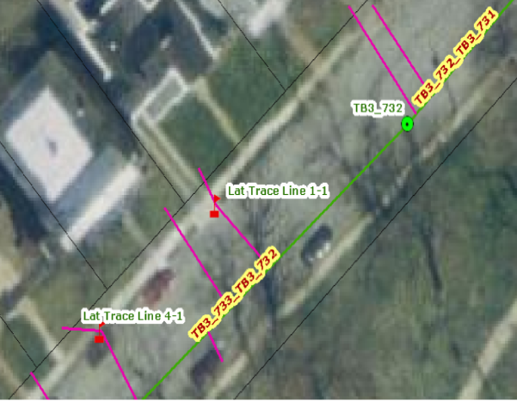
GPS and GIS Mapping –
Allows QA/QC from GIS Data
Short Inspection
Bend

Slide 17
Leading Practices Committee Members
Leading Practices Committee Members
    Greg Scoby – Cross Bore Consultants, LLC
    Annmarie Robertson – PHMSA
    Mark Wallbom, formerly Miller Pipeline / Hydromax USA
  Sub-Committees
    Construction – Mike Kemper, Mears Group - Quanta
    Data Management – Joe Purtell, Cues, Inc.
    Risk Analysis – Mark Wallbom, Hydromax USA
    Stakeholder - Tyler Boyles, Enbridge
    Legacy Installations – Brian Mattson, Digital Control, Inc.
    Legal – Mark Bruce, Hydromax USA

Slide 18
Partial List of Reviewing Organizations
Asked to Participate In Cooperation with CBSA
American Gas Association, AGA
Association of Equipment Manufacturers, AEM
Distribution Contractors Association, DCA
Gas Technology Institute, GTI
National Underground Contractors Assoc., NUCA
Midwest Energy Association, MEA
Northeast Gas Association
Southern Gas Association, SGA
Western Energy Institute, WEI

Slide 19
Leading Practices – Background Chapters
History of Cross Bores
Financial and Social Costs
Current Practice Gaps
Installation Equipment at Risk of Creating Cross Bores
Results of Cross Bores and the Timeline
Responsible Party’s Opportunity to Minimize Cross Bore Risk and Impacts
Regulatory Opportunities
Regulatory Rate Support
Sources of Cross Bore Information

Slide 20
Leading Practices –
Technical Recommendation Chapters
Cross Bore Risk Reduction Goals
Outline of Risk Reduction Project Tasks
Legacy Risk Determination
New Construction Risk Reduction
Data Preservation, Accessibility and Security
Data Use Across the Enterprise
Quality Control
Project Metrics
Public Outreach
- Continued -

Slide 21
Leading Practices –
Technical Recommendation Chapters, (cont.)
Access to Sewer Systems, Public Right of Way and Private Property
Scoping for Cross Bore Risk Reduction Inspections
New Construction Inspections
Robotic Mainline and Launched Lateral CCTV Inspections
Manual Push CCTV Inspections
Vacuum Excavation Used for Cross Bore Risk Reduction
Pull Back Camera Use
Ground Penetrating Radar Use
Other Emerging Tools for Future Consideration
- Continued -

Slide 22
Leading Practices –
Technical Recommendation Chapters, (cont.)
Locating Field Work
Proximity Determinations
Clean Out Installation Use
Occupant Notifications
----------------------------------------------------------------------------------------
Summary
References
Definitions
Appendix A: Publications
Appendix B: Examples for Notices, Door Hangers and Letters

Slide 23
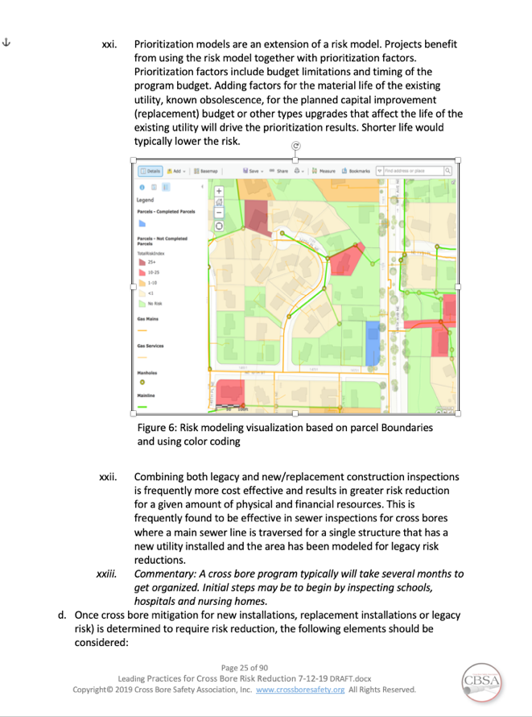
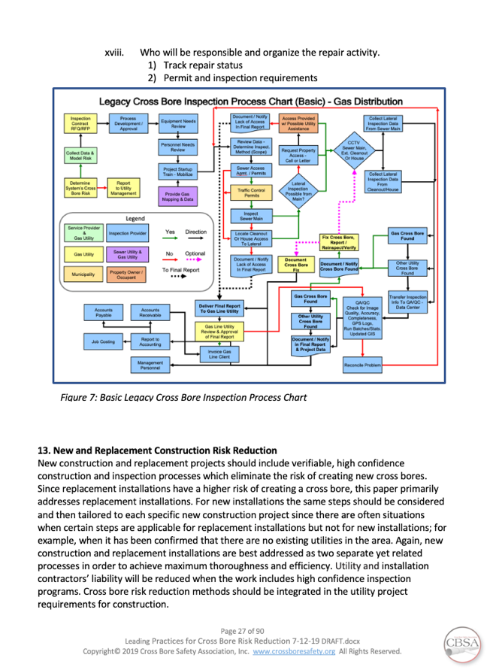
Risk Modeling & Prioritization / Project Flow Chart

Slide 24
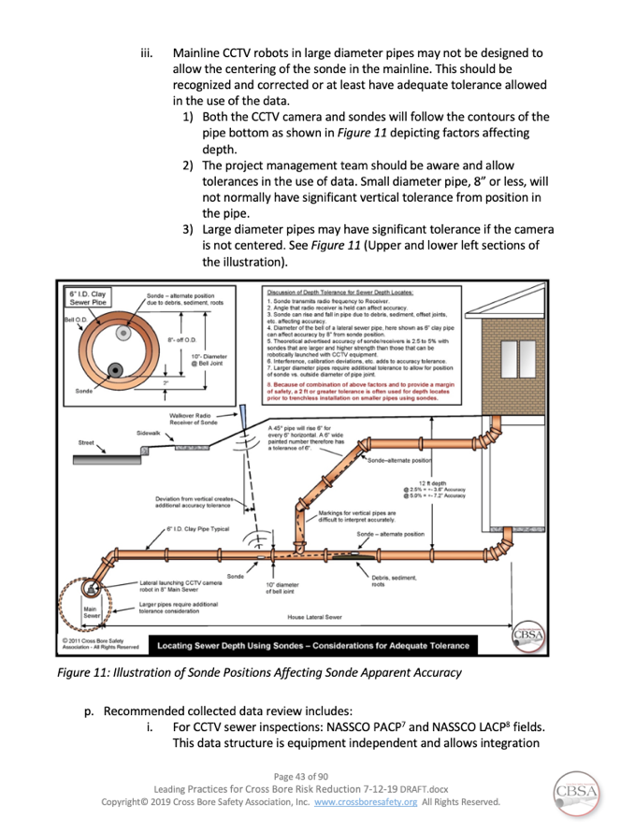
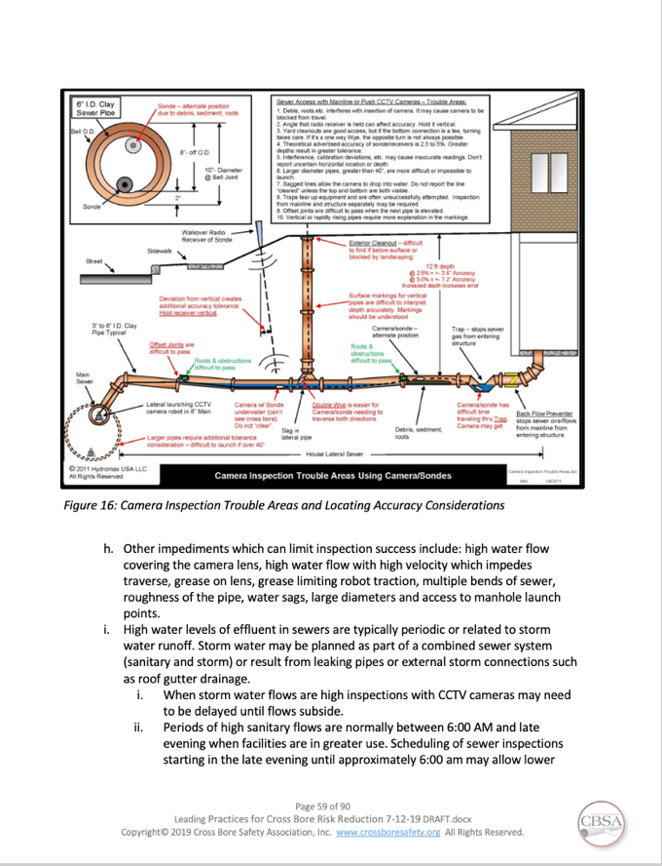
Sewer Inspection Challenges

Slide 25
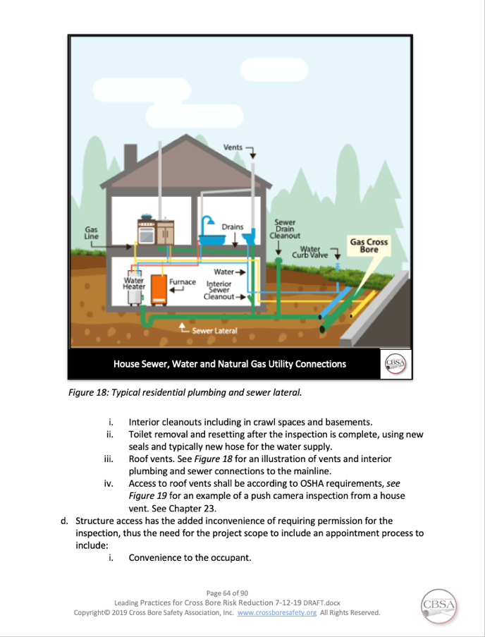
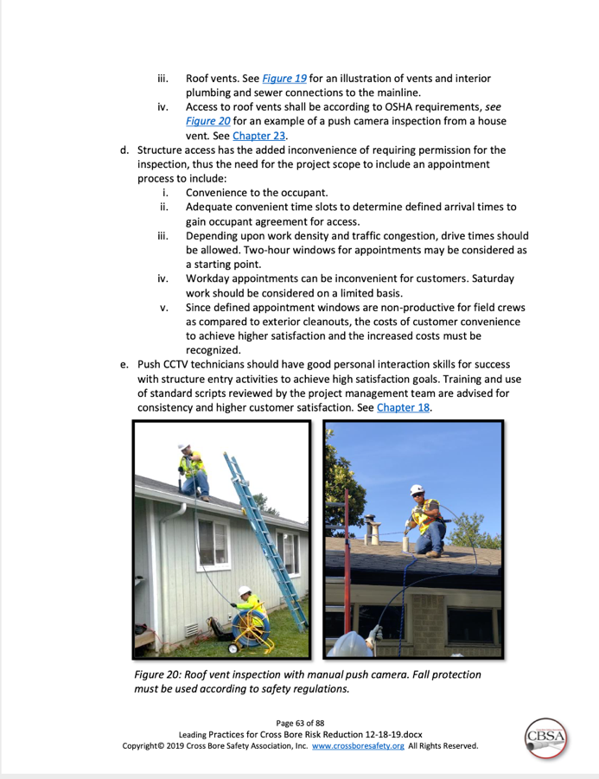
Accessing Sewers from Structures

Slide 26
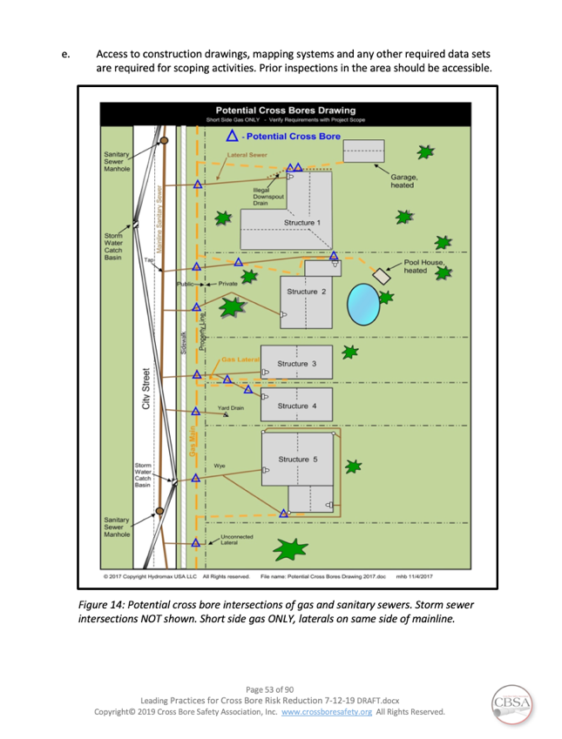
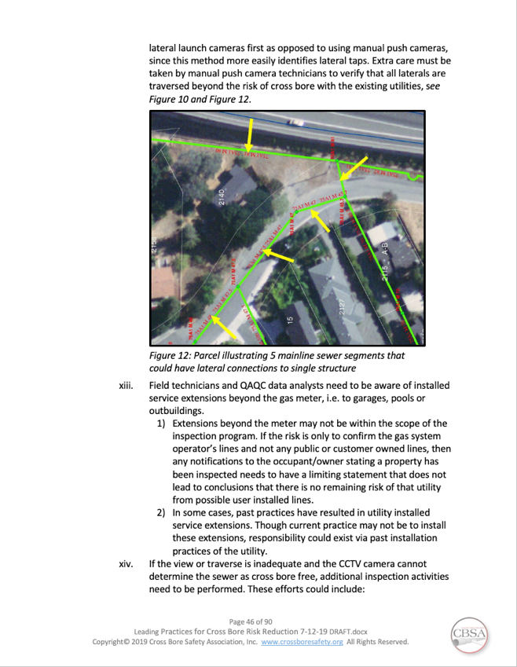
Cross Bore Intersections – Sanitary and Gas

Slide 27
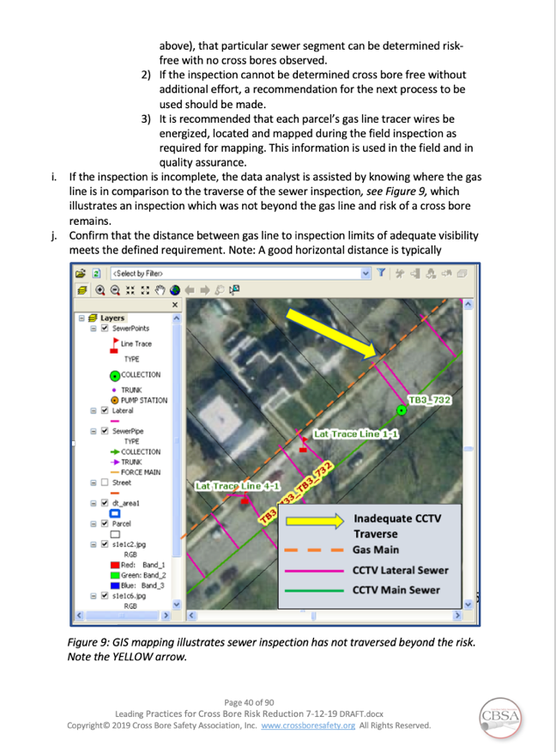
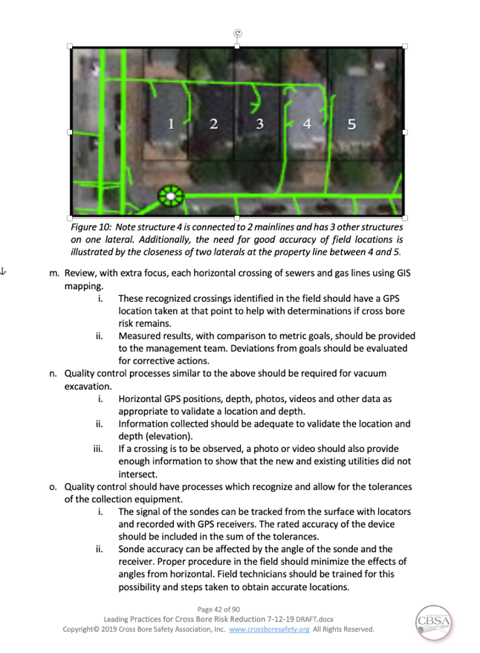
GIS Based Data Recommended

Slide 28
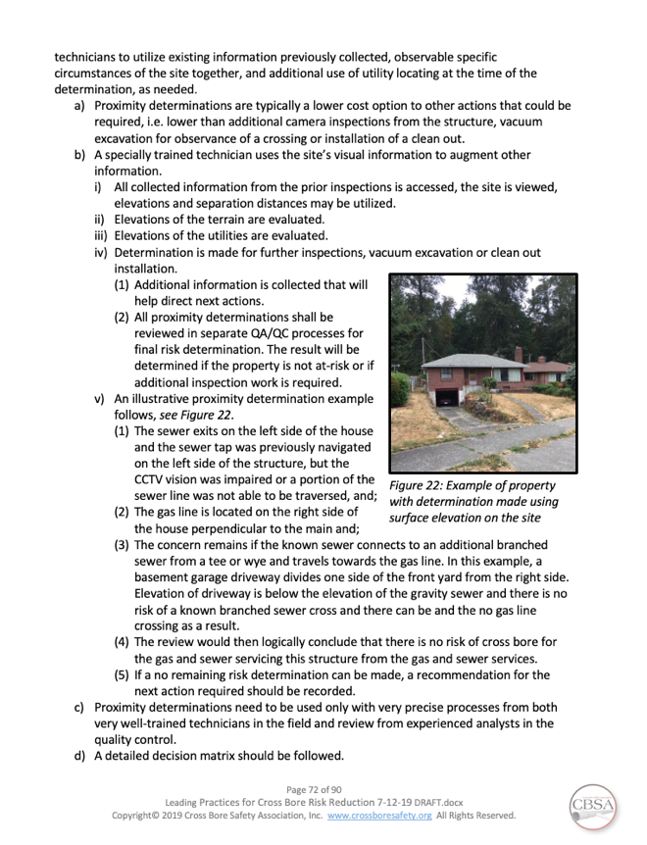
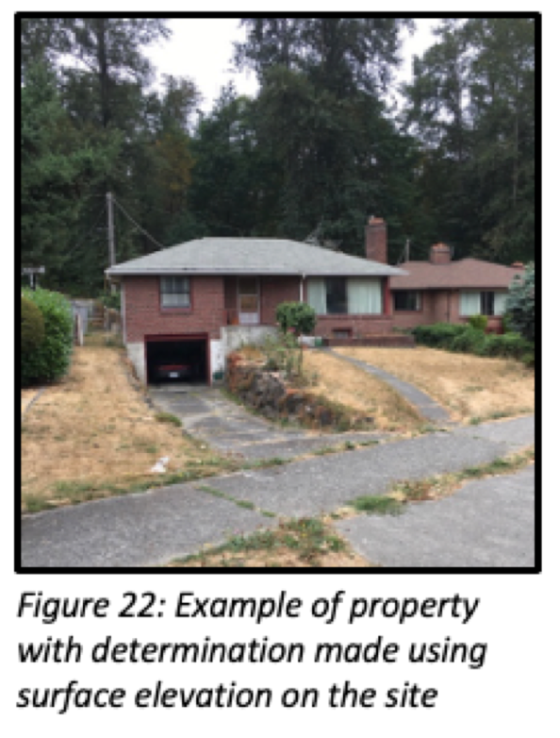
Proximity Determinations

Slide 29
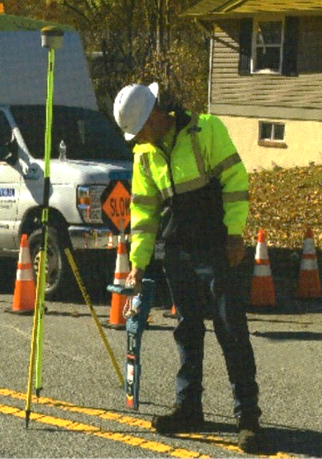
GPS / GIS Mapping

Slide 30

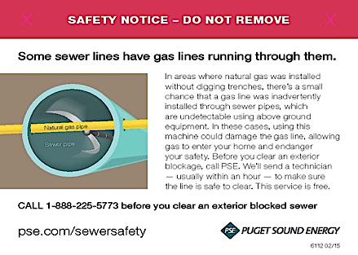

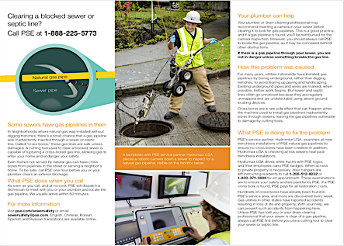
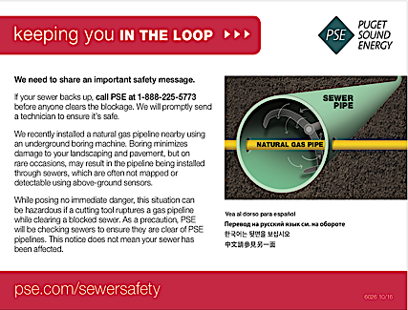
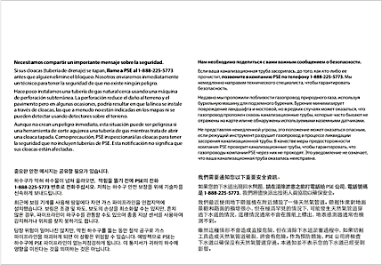

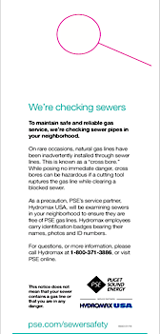
Public Awareness & Form Samples
(consider multi-language when appropriate)

Slide 31
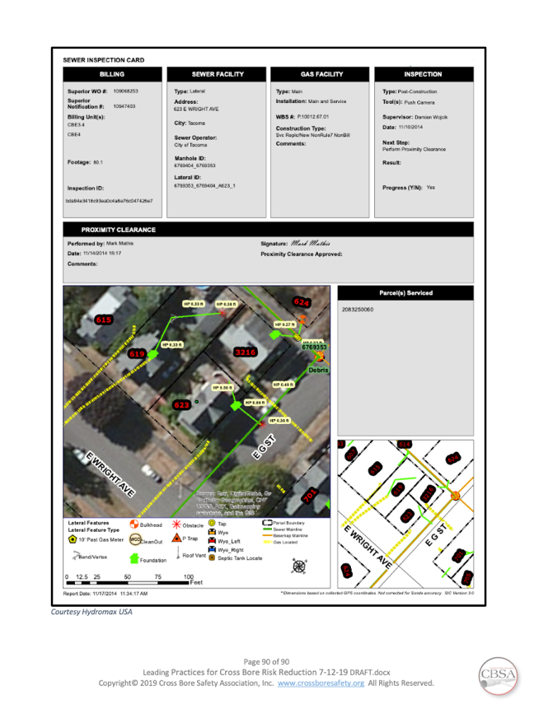
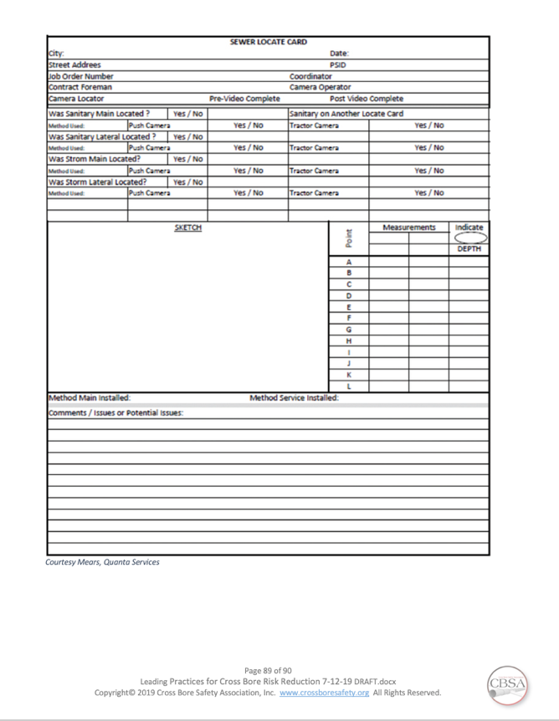
Digital vs. Manual Reporting

Slide 32
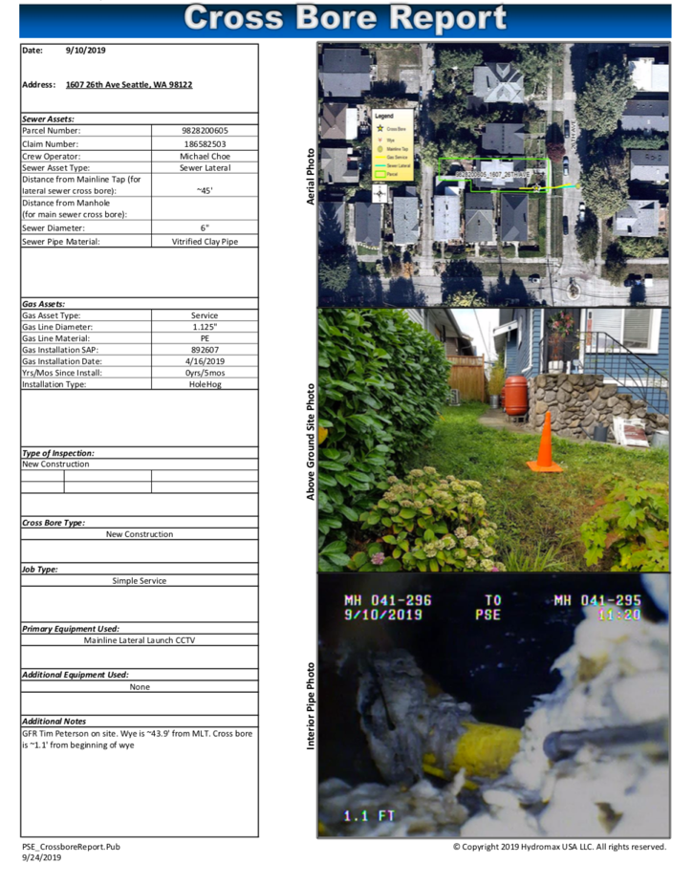
Cross Bore Report - GIS Based

Slide 33
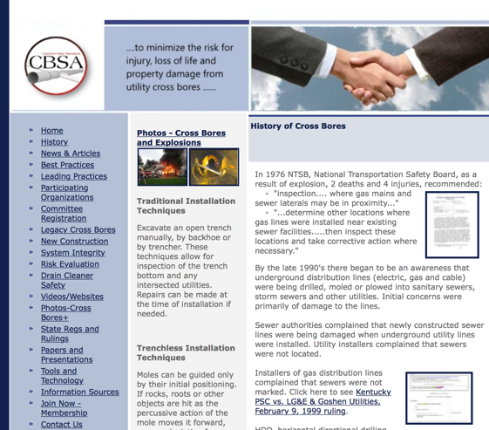
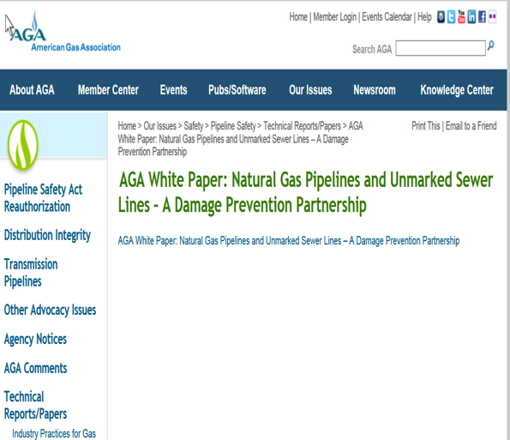
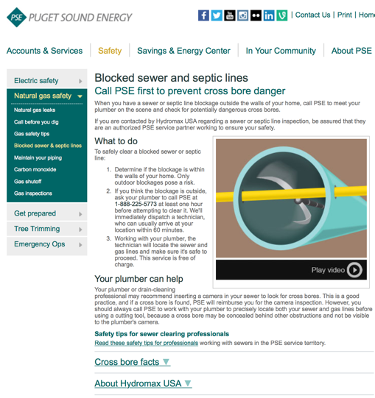
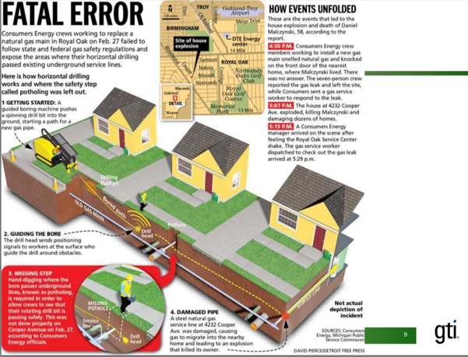
Cross Bore Info Online
Notes:
Make your program positive to the community. Ask for their cooperation.

Slide 34
Stakeholders Addressed
Stakeholders Interests are Included
  Public & Public Outreach
  Utility Planning
  Utility Project Managers
  Installing Contractor
  Inspection Company
  Vacuum Excavation
  Quality Control
  Mapping
  Drain Cleaners
  IT and Data Preservation
  Regulators, Rates and Requirements

Slide 35



CBSA’s Leading Practices for Cross Bore Risk Reduction
Questions
Get the Leading Practices through your participating organization or through the Cross Bore Safety Association www.crossboresafety.org

